Slide 1

FITNESS FUSION
.

Slide 2
TEAM MEMBERS:
Abhishek Bose
Aarchishman Mukherjee
Chandraday Chakraborty
Arghyadeep Kundu
Masud Hasan
Ankush Ghosh

Slide 3
COCOMO

Slide 4
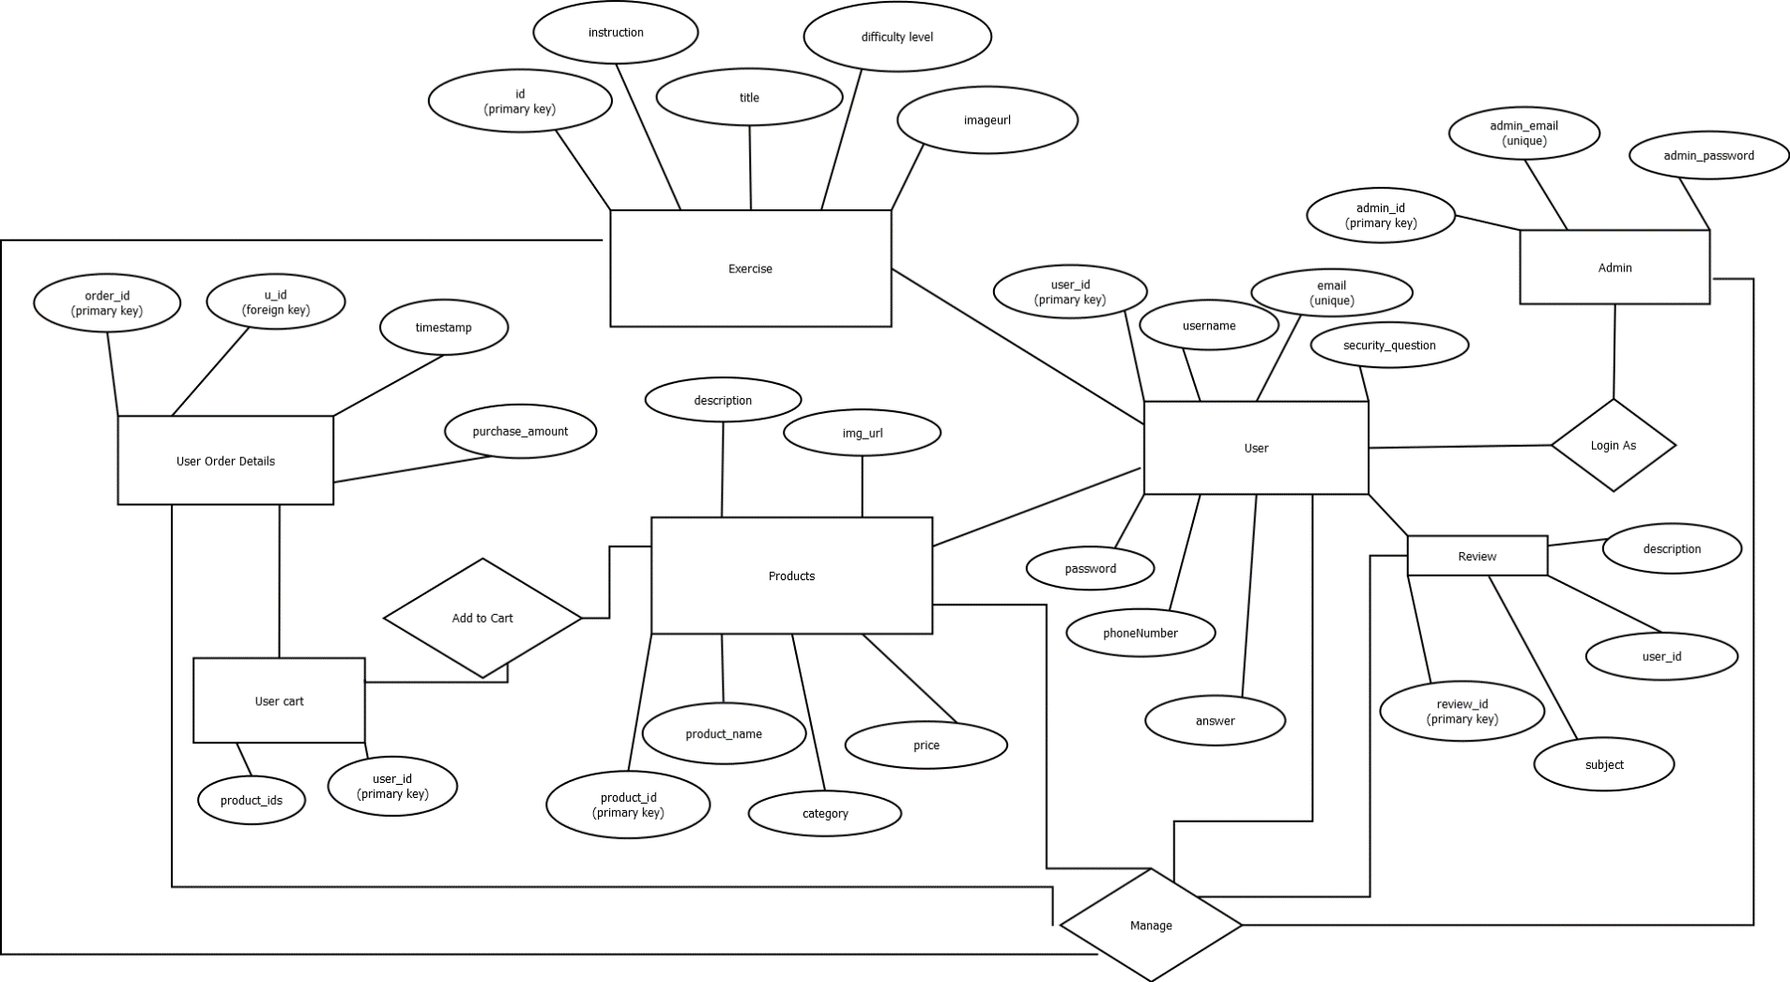
ERD:

Slide 5
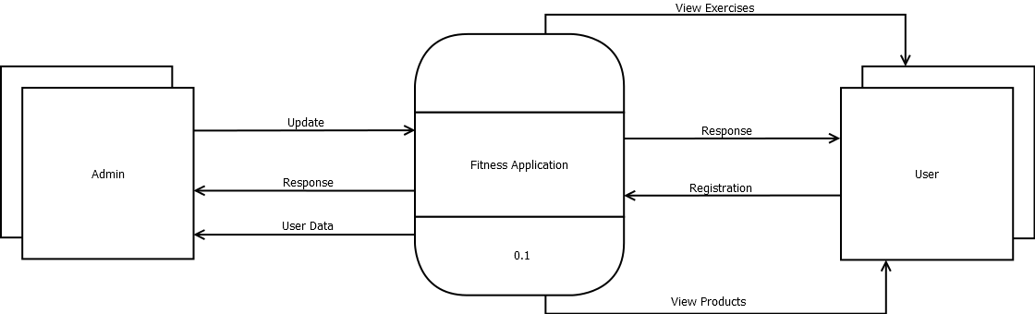
DFD: LEVEL 0

Slide 6
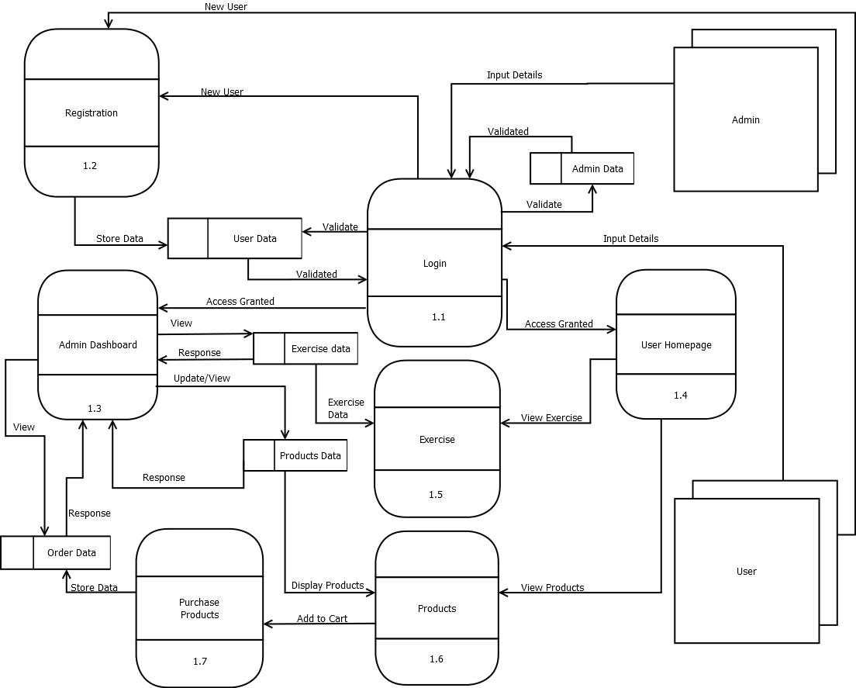
DFD: LEVEL 1 & LEVEL 2

Slide 7
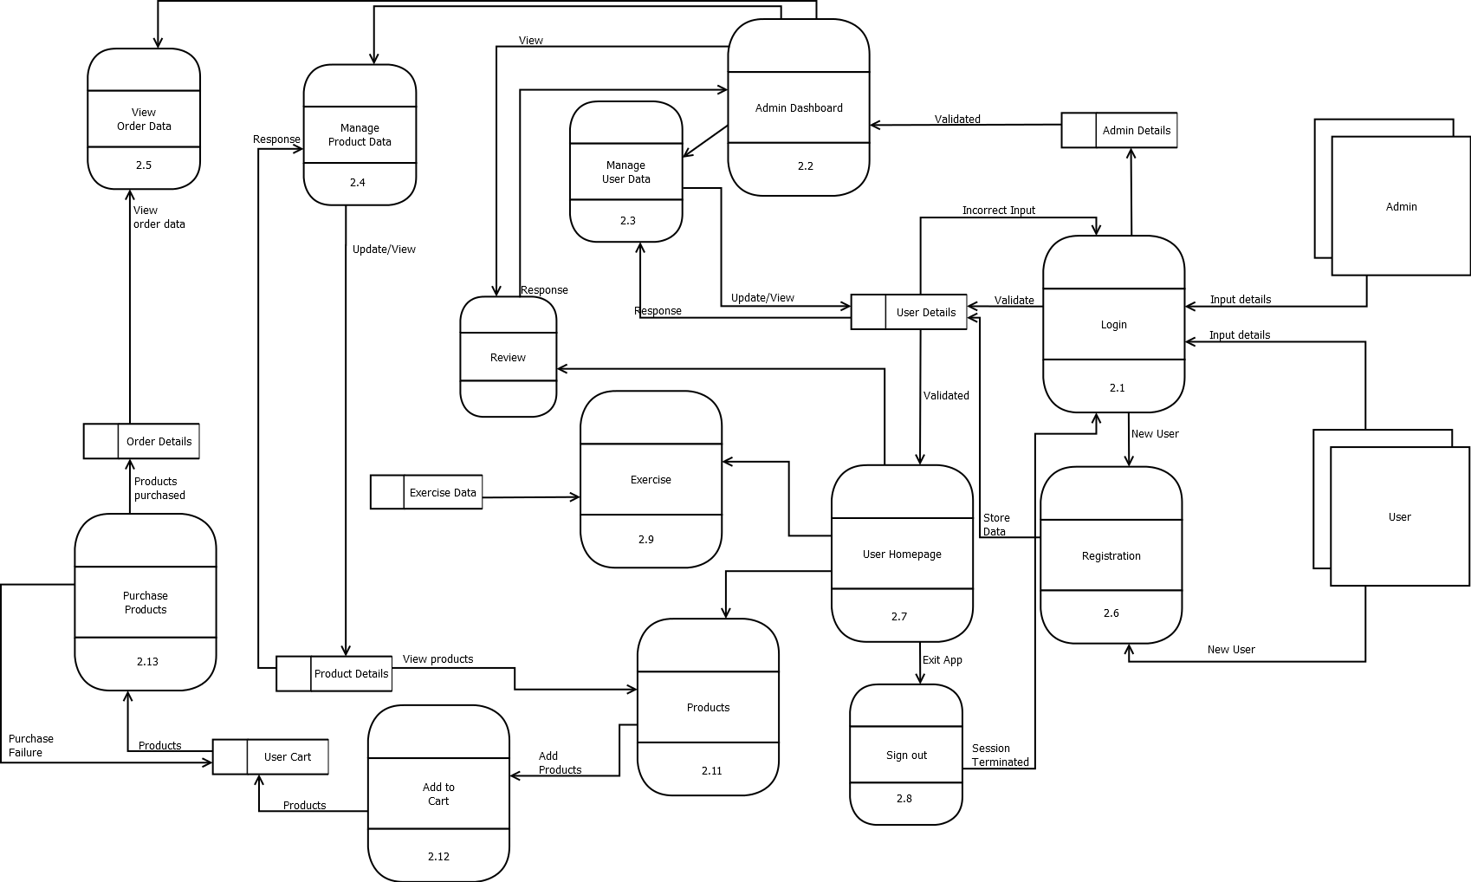
DFD: LEVEL 2

Slide 8
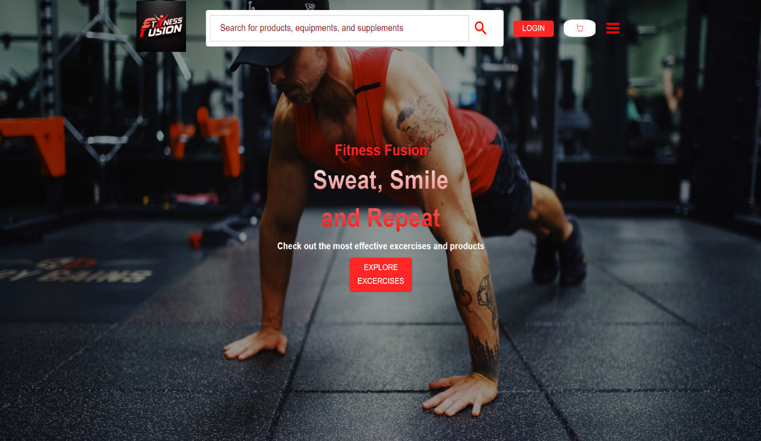
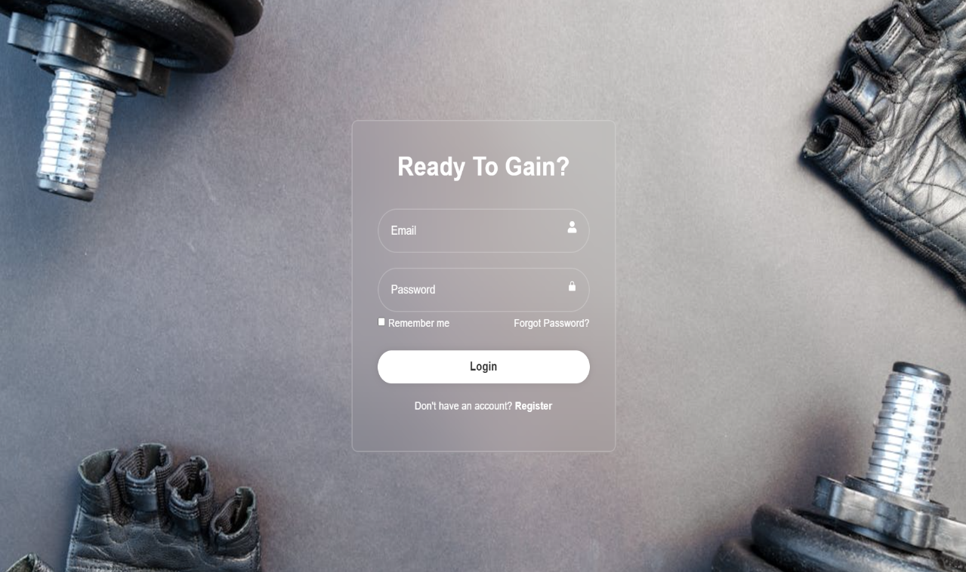
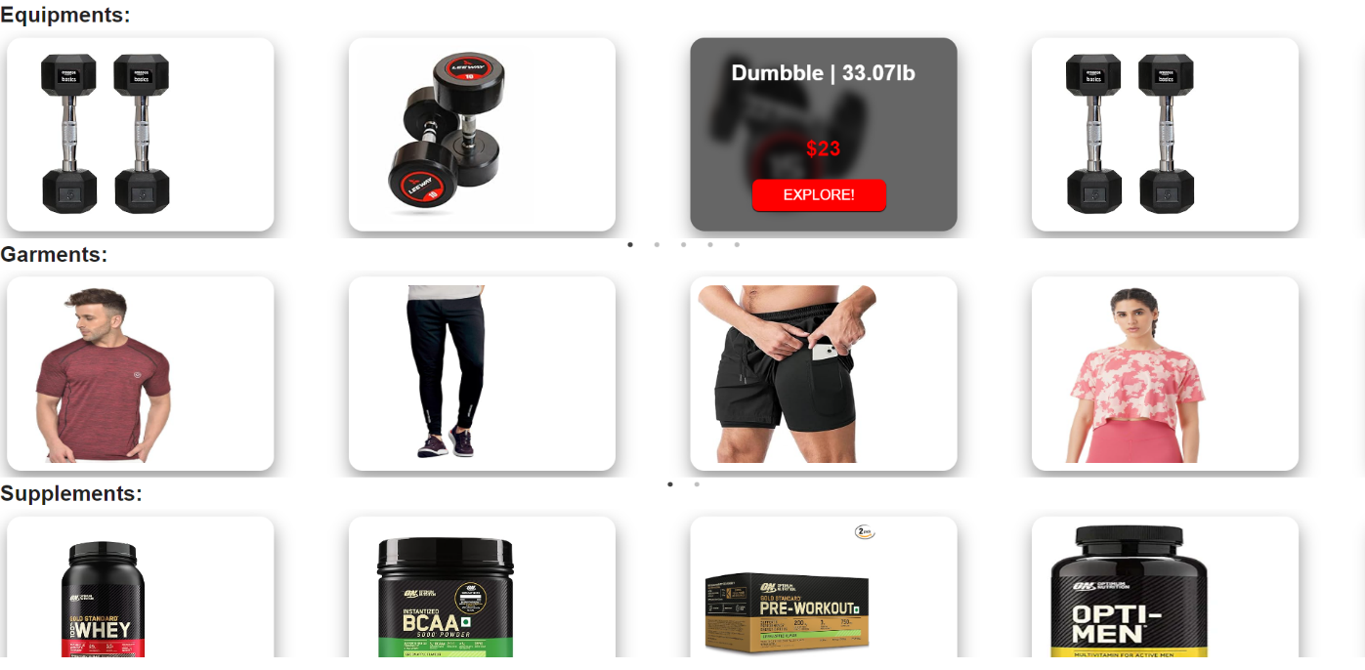
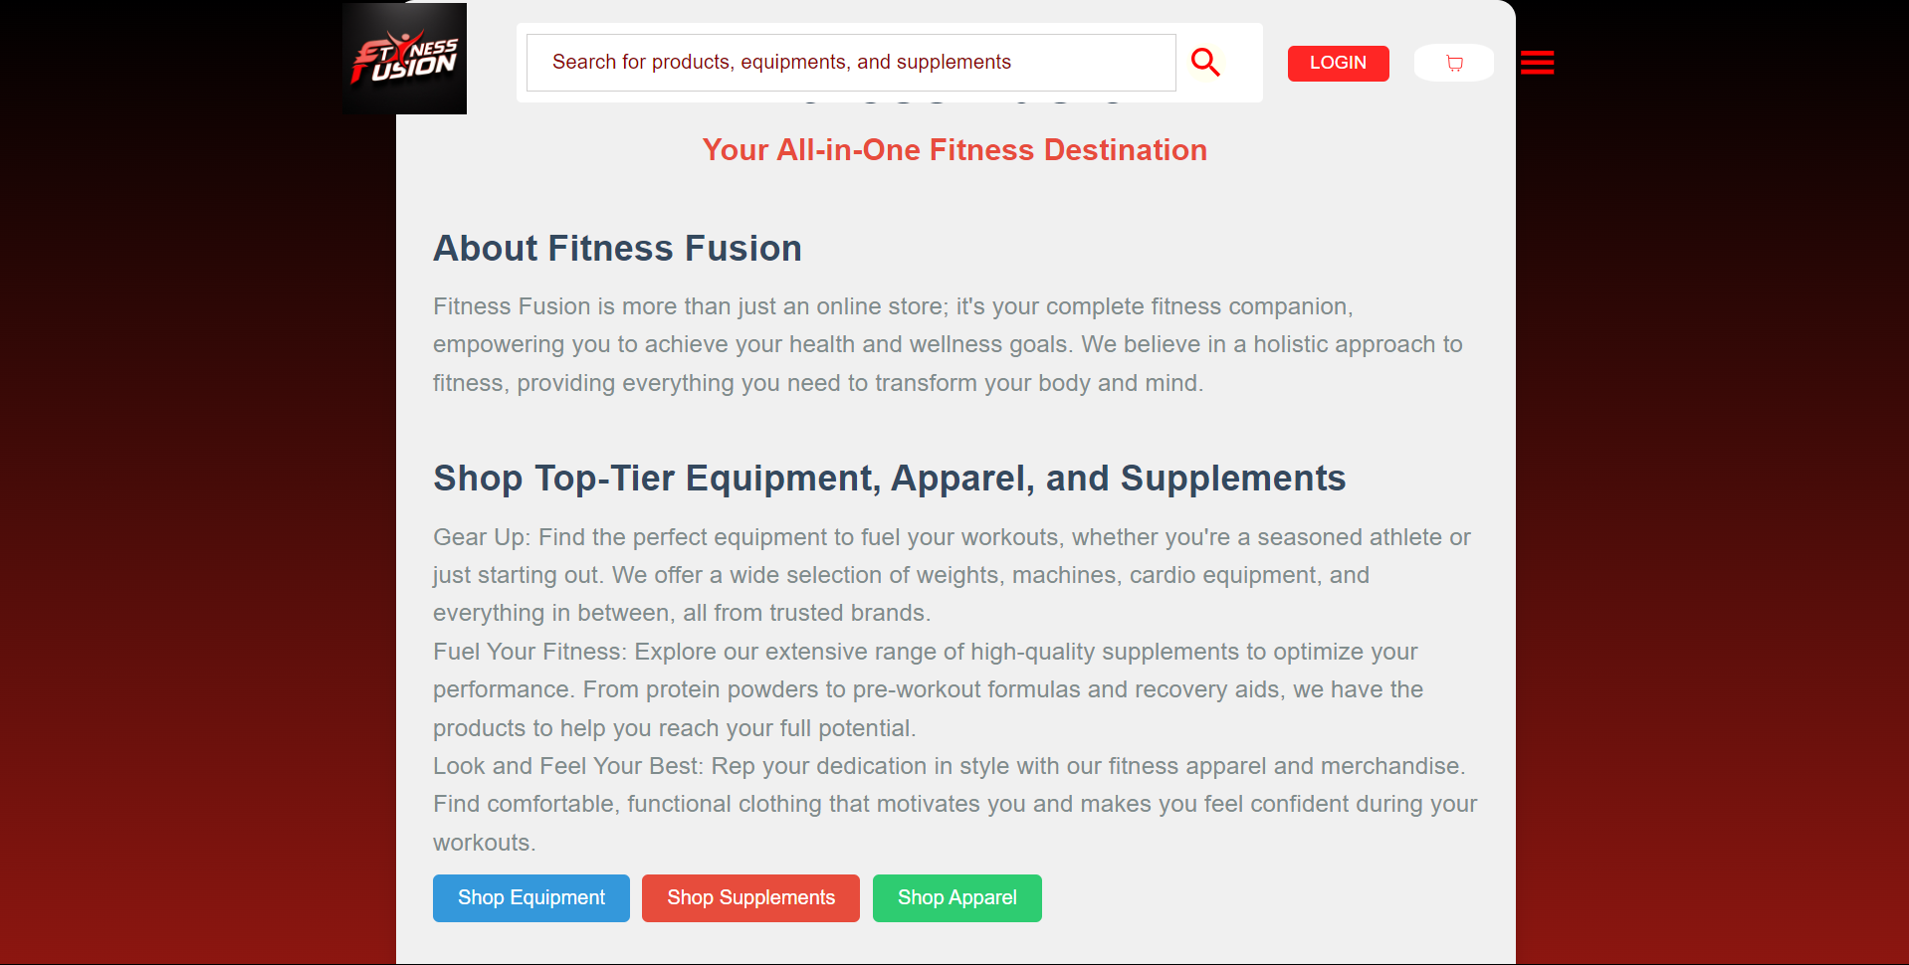
.
Home
Login
Carousel
About Us

Slide 9
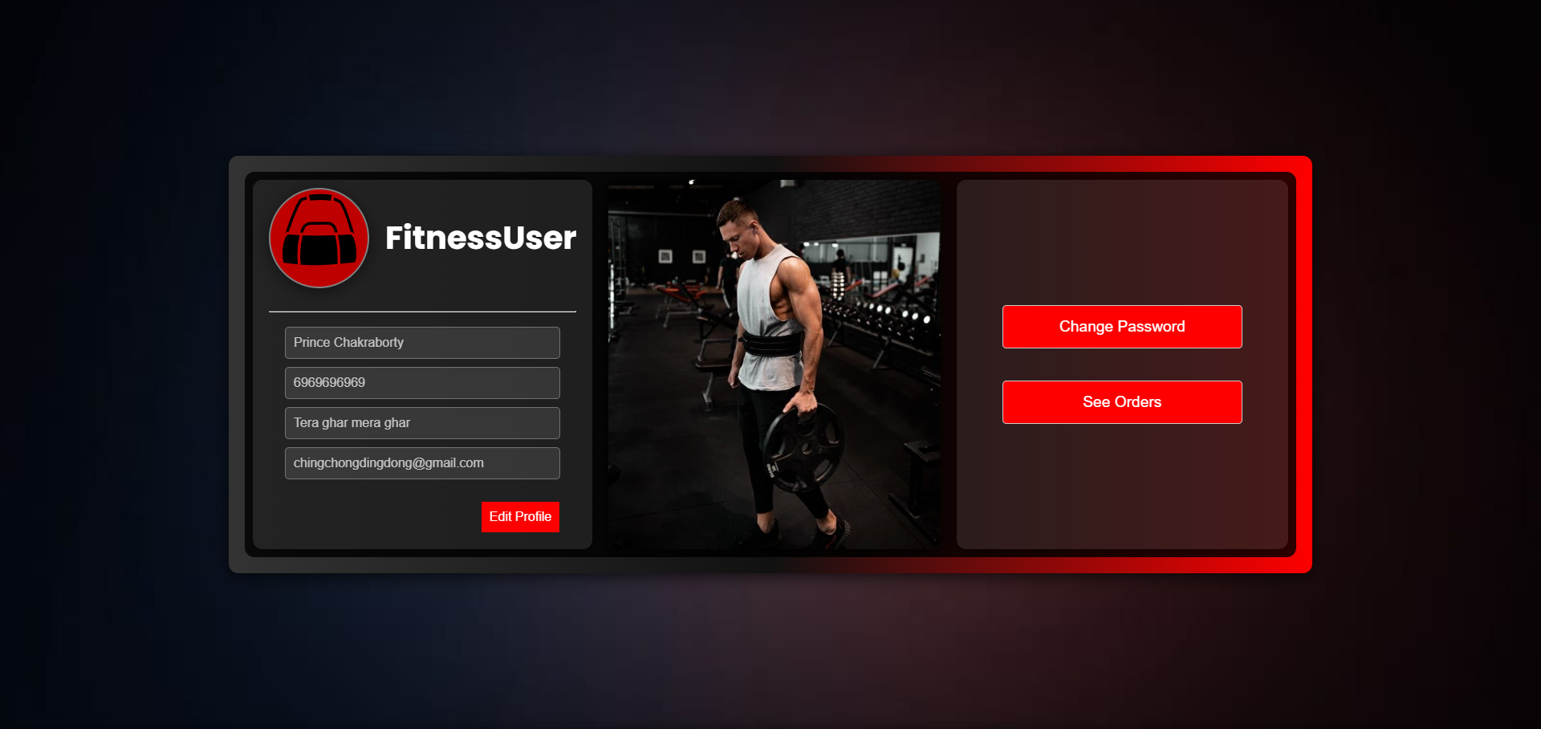
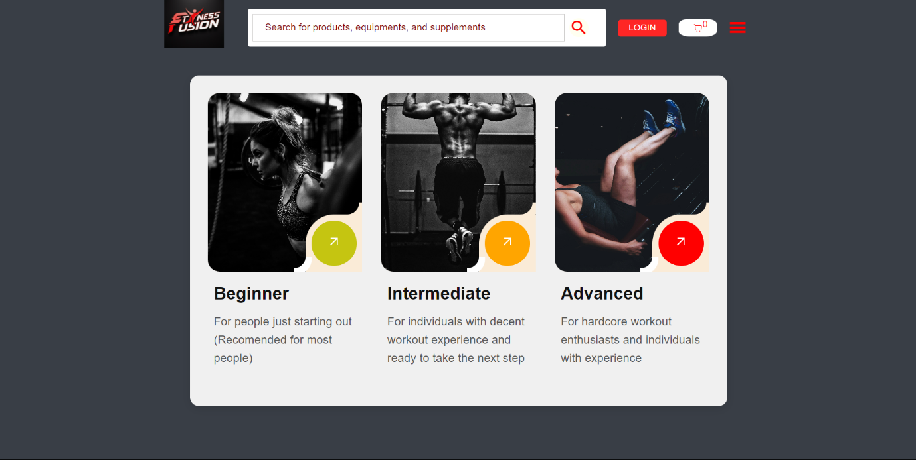
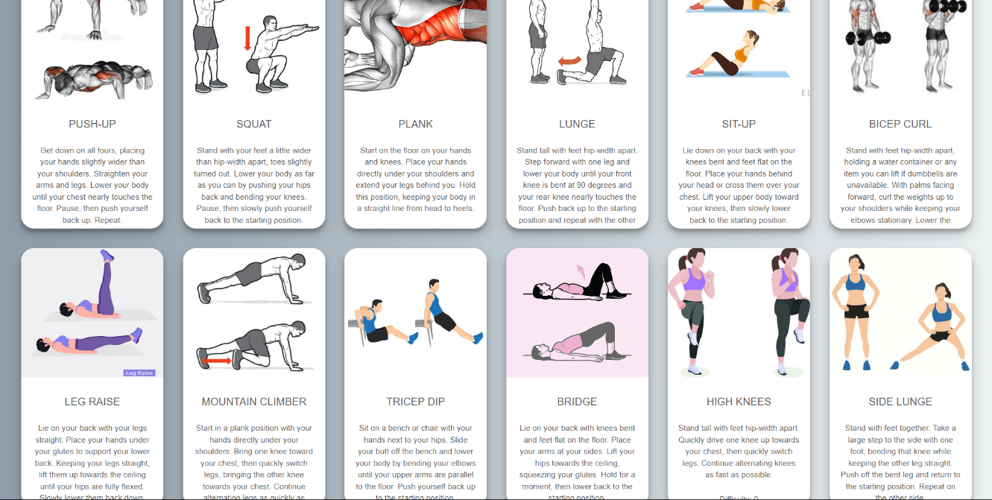
.
Profile Page
Exercise Types
Exercise Display

